Slide 1
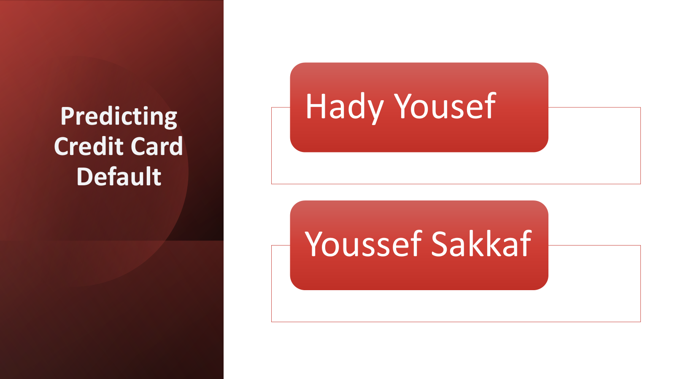

Slide 2
Can we predict who will miss a payment?
30,000 customers
Real credit card customer data from a bank in Taiwan (April–September 2005).
23 pieces of information
Credit limit, age, gender, education, marital status, bills, payments and payment history.
Yes / No target
Whether the customer missed the following month's payment.
CA1 objective
Clean and prepare the data for credit default prediction in CA2.

Slide 3
Payment history is the biggest warning sign
% who missed their next payment, by how they paid in September
Late payers tend to miss again
69% of customers who were 2 months late missed the next payment, compared with 13–17% of those who weren't late.
Most customers did pay
Only 22% missed a payment. A model that always guesses "they'll pay" would be 78% accurate but useless, so accuracy alone is misleading.
The data was complete
No missing values. The size of someone's bill had almost no link to missing a payment.
Notes:
The clearest pattern was payment history. Customers who were already two months late missed the next payment 69% of the time, compared with 13 to 17% of customers who weren't late.
Only 22% missed a payment, so the groups are uneven. A lazy model that always says 'they'll pay' would be 78% accurate and still useless, so accuracy alone won't be enough later.
The good news: there were no missing values.

Slide 4
Cleaning the data
Removed | The ID column (just a row number) and 35 duplicate rows, leaving 29,965 customers
Grouped | Unknown education and marriage codes into the existing "Other" group
Kept | Extreme values: very large bills and payments belong to real customers, not mistakes
Converted | Categories into numbers: gender became 0/1, education and marital status became yes/no columns (one-hot encoding)
Rescaled | Put every number on a similar scale so large values like the credit limit don't dominate (log transform and standard scaling)
Rule we followed: keep the customers, fix the values. Only duplicate rows were removed.
Notes:
For cleaning, our rule was: keep the customers, fix the values. We only deleted the ID column and 35 duplicate rows.
Some education and marriage codes weren't explained anywhere, so we grouped them into 'Other'. We kept extreme values, because they're real customers.
Models only understand numbers, so categories like education became yes/no columns — that's called one-hot encoding. And we rescaled the numbers so a big value like the credit limit doesn't drown out the rest.

Slide 5
Train and test data: no peeking
80% Training data
23,972 customers · the model learns from these
20% Test
5,993 · kept aside
Both parts keep the same 22% rate of missed payments (a stratified split).
Why split?
Avoiding data leakage
The test data works like an exam the model has never seen. Its score shows how well the model will do on new customers.
If the test data shapes our decisions, it's like seeing the exam answers early: the score looks better than it really is. So we split first, and every later step learned from the training data only.
Notes:
Before learning anything from the data, we split it: 80% for training, 20% kept aside for testing. Both parts have the same 22% of missed payments.
Think of the test data as an exam the model has never seen. If we let it influence our decisions, it's like seeing the answers early — the score would look better than it really is. That's called data leakage, and avoiding it shaped everything we did after this point.

Slide 6
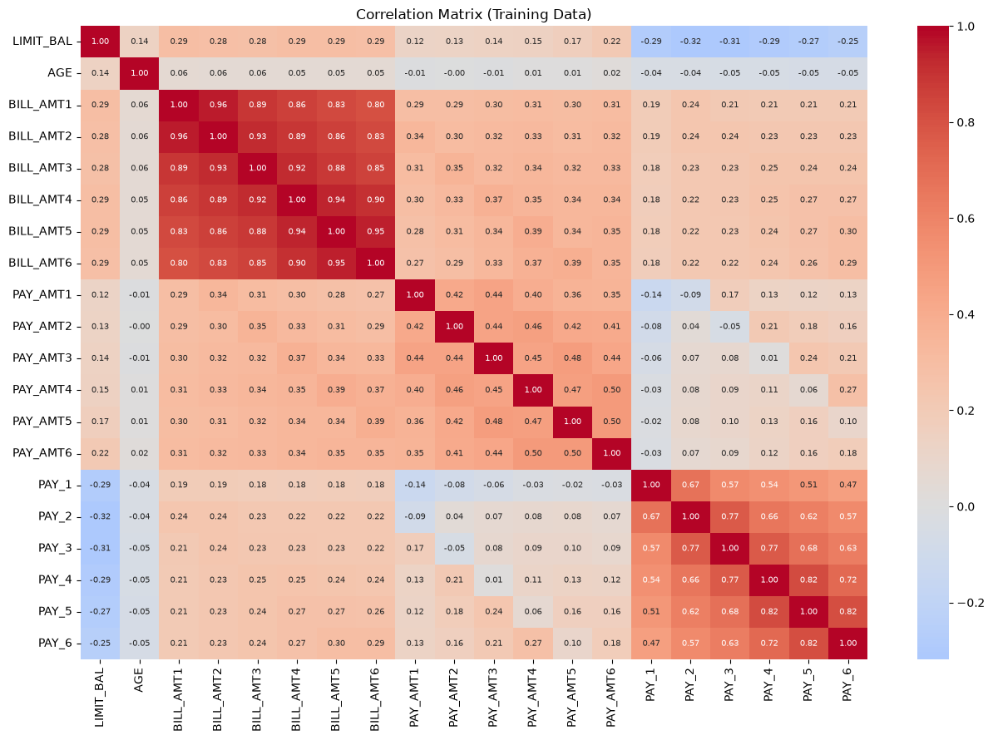
Some columns repeat the same information
How to read it
Each square compares two columns. Dark red signifying a correlation close to 1 (they rise and fall together)
The 6 monthly bills are almost the same
Correlations of 0.80 to 0.96: this month's bill looks a lot like last month's.
Payment history overlaps too
The 6 months of payment history correlates at 0.47 to 0.82.
Why it matters
The repeated information can confuse certain models (multicollinearity)
Notes:
[Part B — Youssef]
Next we checked whether columns repeat each other. In this chart, every square compares two columns, and dark red means they move together.
The big red block is the six monthly bills — they're almost the same, because your bill this month looks like last month's. Payment history overlaps too. Having the same information many times can confuse some models; that's called multicollinearity. We tried two ways to fix it.

Slide 7
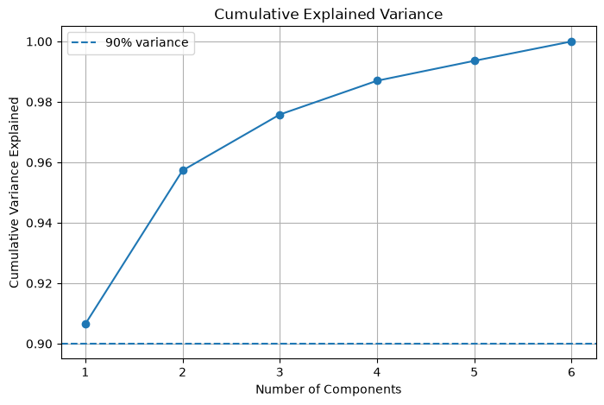
PCA: combining the six bills into one
What PCA does
Similar columns are merged into fewer new ones, while keeping as much information as possible
What we got
One new column kept 90.6% of the information in all six bills. It essentially measures how big customer's balance are.
Why we didn't use it
It predicted missed payments no better than a single month's bill, and it's harder to explain. So we maintained original columns.
Notes:
First we tried PCA, short for Principal Component Analysis. It merges similar columns into fewer new ones while keeping most of the information.
One new column kept 90.6% of the information from all six bills — basically, how big the customer's balance is.
But PCA keeps information, not predictive power. The new column didn't predict missed payments any better than a single month's bill, and it's harder to explain, so we kept the original columns.

Slide 8
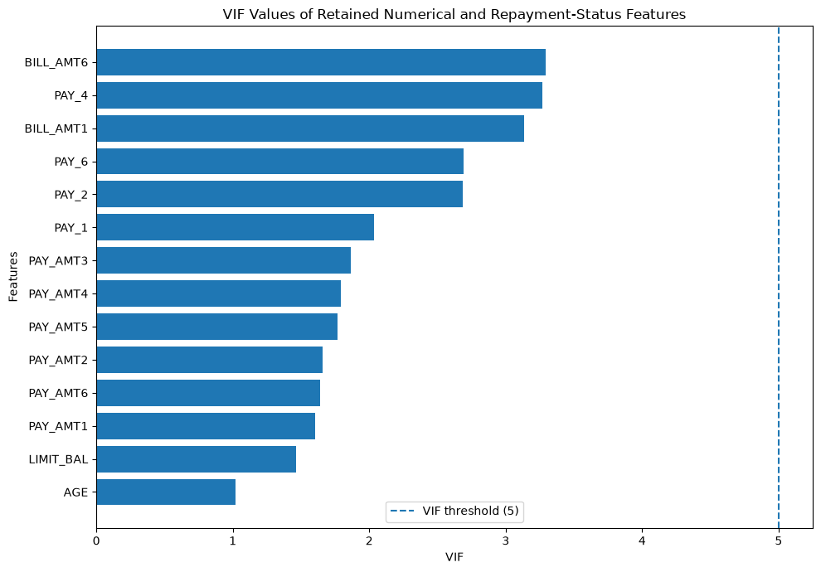
Removing repeated columns with VIF
What VIF measures
How easily a column can be guessed from the other columns. Above 5 means it's too repetitive.
What we did
Removed the most repetitive column, checked again, and kept repeating until every column reached below 5.
What was removed
4 of the 6 monthly bills and 2 months of payment history. We also dropped one yes/no column per category group, given that it can always be worked out from the others anyways.
28 → 20 columns
After removal, every remaining column is below the limit of 5
Notes:
Our second tool was VIF. It measures how easily one column can be guessed from all the others — above 5 means it's too repetitive.
We removed the most repetitive column, checked again, and kept going until everything was below 5. Re-checking each time matters, because removing one bill made the others look much less repetitive.
In the end, four bills and two months of payment history were removed. Together with the other checks, that took us from 28 columns to 20.

Slide 9
The final dataset: 20 columns
4
9
7
Payment history
Money
Profile
Has the customer late in September, August, June and April?
Credit limit, all bills for September to April, and payments for all 6 months
Age, gender, education level and marital status
Preparing our next steps for CA2: 23,972 training customers and 5,993 test customers, both with 22% missed payments. The test data was never used to make any decision.
Notes:
So the final dataset has 20 columns in three groups: payment history, money amounts, and profile details.
We hand over 23,972 training customers and 5,993 test customers, both with the same 22% missed payments. Every step was learned from the training data only, so the test data stays a fair exam for the models in CA2.

Slide 10
Fairness and limitations
Fairness
Limitations
Gender, marital status and age describe who someone is, not how they handle money.
The EU AI Act treats all credit scoring as high-risk AI, which means it needs care.
These columns barely relate to missed payments, so we recommend testing the model without them and checking it treats groups equally.
Some codes in the data aren't explained in its documentation, so we had to make assumptions
The VIF limit of 5 is a rule of thumb; a limit of 10 would have kept 3 more columns
Our checks only spot straight-line (linear) relationships
The data is from Taiwan in 2005 and may not match lending today
Notes:
Finally, fairness. Gender, marital status and age describe who someone is, not how they manage money, and the EU AI Act treats credit scoring as high-risk. They barely relate to missed payments anyway, so we recommend testing the model without them.
Our main limitations: some codes weren't documented so we made assumptions, the VIF limit is a rule of thumb, our checks only see straight-line relationships, and the data is from Taiwan in 2005.

Slide 11
Thank you. Any questions?
Hady Yousef · Youssef Sakkaf
Notes:
That's our project. Thanks for listening — we're happy to answer any questions.

